Slide 1
Getting Started with Serverless Architectures
<Ronald RC>

Slide 2
Agenda
Background
Principles
Use cases
Patterns
Cloud Providers
Serverless Framework
Demo

Slide 3
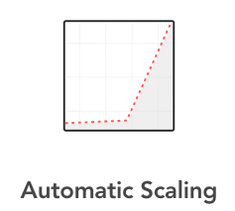
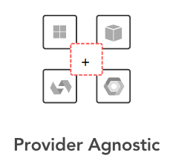
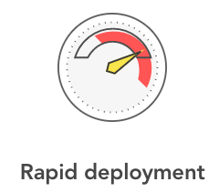
Background
… Serverless computing as a new and efficient software development approach that abstracts infrastructure from the functionality itself …
Cagatay Gurturk (Building Serverless Architectures)
Notes:
Serverless es un nuevo y eficiente enfoque de desarrollo de software que abstrae la infraestructura de la funcionalidad
Desarrollar, probar e implementar en un único entorno, en cualquier proveedor de la nube.
No tiene que aprovisionar infraestructura ni preocuparse por la escala.

Slide 4
Principles
Use a compute service to execute code on demand (no servers)
Write single-purpose stateless functions
Design push-based, event-driven pipelines
Create thicker, more powerful front ends
Embrace third-party services
Notes:
AWS Events
API Gateway
Streams
S3
Schedule
SNS
Alexa Skill
Alexa Smart Home
IoT
CloudWatch Event
CloudWatch Log
Cognito User Pool

Slide 5
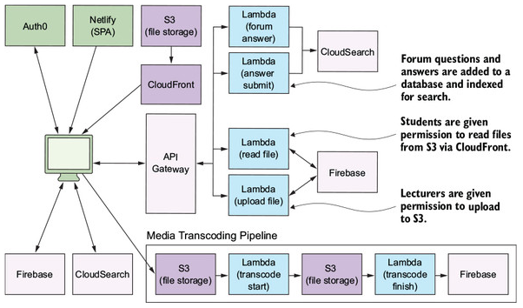
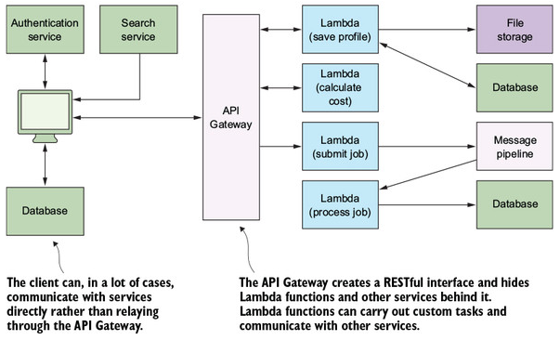
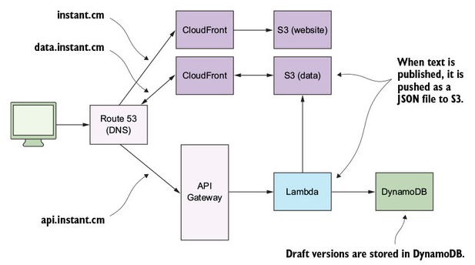
Use Cases
Application Backend
Legacy API Proxy
Hybrid
Real-time processing and analytics
Push-based and event-driven
Notes:
A Cloud Guru (https://acloud.guru) is an online education platform for solution architects, system administrators, and developers wanting to learn Amazon Web Services. The core features of the platform include (streaming) video courses, practice exams and quizzes, and real-time discussion forums. A Cloud Guru is also an e-commerce platform that allows students to buy courses and watch them at their leisure. Instructors who create courses for A Cloud Guru can upload videos directly to an S3 bucket, which are immediately transcoded to a number of different formats (1080p, 720p, HLS, WebM, and so on) and are made available for students to view. The Cloud Guru platform uses Firebase as its primary client-facing database, which allows clients to receive updates in near real time without refreshing or polling (Firebase uses web sockets to push updates to all connected devices at the same time). Figure 2.2 shows a cut down version of the architecture used by A Cloud Guru.
Instant (http://instant.cm) is a startup that helps website owners add content management facilities—including inline text editing and localization—to their static websites. The founders, Marcel Panse and Sander Nagtegaal, describe it as instant content management system. Instant works by adding a small JavaScript library to a website and making a minor change to HTML. This allows developers and administrators to edit text elements directly via the website’s user interface. Draft edits made to the text are stored in DynamoDB (see appendix A on DynamoDB). The final, production version of the text (that the end user sees) is served as a JSON file from an S3 bucket via Amazon CloudFront (figure 2.3).

Slide 6
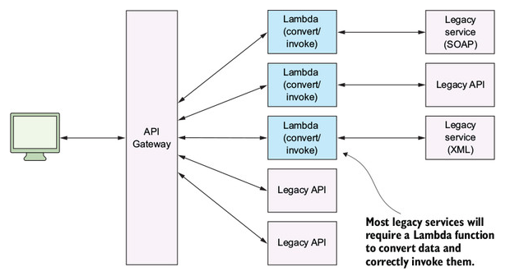
Use Cases
Application Backend
Legacy API Proxy
Hybrid
Real-time processing and analytics
Push-based and event-driven
Notes:
The legacy API proxy architecture is an innovative example of how serverless technologies can solve problems. As we mentioned in section 2.1.4, systems with outdated services and APIs can be difficult to use in modern environments. They might not conform to modern protocols or standards, which might make interoperability with current systems harder. One way to alleviate this problem is to use the API Gateway and Lambda in front of those legacy services. The API Gateway and Lambda functions can transform requests made by clients and invoke legacy services directly, as shown in figure 2.5.

Slide 7
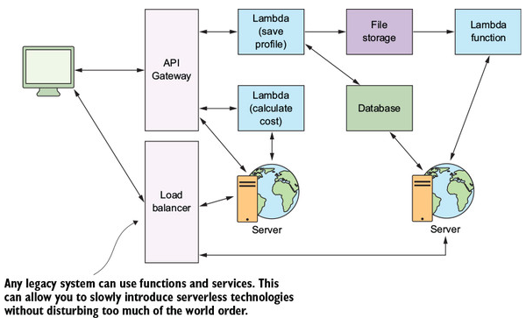
Use Cases
Application Backend
Legacy API Proxy
Hybrid
Real-time processing and analytics
Push-based and event-driven
Notes:
The legacy API proxy architecture is an innovative example of how serverless technologies can solve problems. As we mentioned in section 2.1.4, systems with outdated services and APIs can be difficult to use in modern environments. They might not conform to modern protocols or standards, which might make interoperability with current systems harder. One way to alleviate this problem is to use the API Gateway and Lambda in front of those legacy services. The API Gateway and Lambda functions can transform requests made by clients and invoke legacy services directly, as shown in figure 2.5.

Slide 8
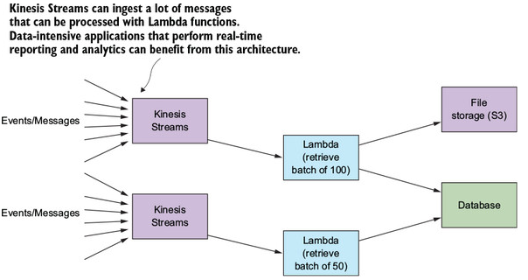
Use Cases
Application Backend
Legacy API Proxy
Hybrid
Real-time processing and analytics
Push-based and event-driven
Notes:
The legacy API proxy architecture is an innovative example of how serverless technologies can solve problems. As we mentioned in section 2.1.4, systems with outdated services and APIs can be difficult to use in modern environments. They might not conform to modern protocols or standards, which might make interoperability with current systems harder. One way to alleviate this problem is to use the API Gateway and Lambda in front of those legacy services. The API Gateway and Lambda functions can transform requests made by clients and invoke legacy services directly, as shown in figure 2.5.

Slide 9
Use Cases
Application Backend
Legacy API Proxy
Hybrid
Real-time processing and analytics
Push-based and event-driven
Notes:
The legacy API proxy architecture is an innovative example of how serverless technologies can solve problems. As we mentioned in section 2.1.4, systems with outdated services and APIs can be difficult to use in modern environments. They might not conform to modern protocols or standards, which might make interoperability with current systems harder. One way to alleviate this problem is to use the API Gateway and Lambda in front of those legacy services. The API Gateway and Lambda functions can transform requests made by clients and invoke legacy services directly, as shown in figure 2.5.

Slide 10
Patterns
Command Pattern
Messaging Pattern
Priority Pattern
Fan-out Pattern
Pipes and filters pattern
Notes:
This pattern is useful if you want to decouple the caller and the receiver. Having a way to pass arguments as an object, and allowing clients to be parametrized with different requests, can reduce coupling between components and help make the system more extensible. Be aware of using this approach if you need to return a response to the API Gateway. Adding another function will increase latency.

Slide 11
Patterns
Command Pattern
Messaging Pattern
Priority Pattern
Fan-out Pattern
Pipes and filters pattern
Notes:
This is a popular pattern used to handle workloads and data processing. The queue serves as a buffer, so if the consuming service crashes, data isn’t lost. It remains in the queue until the service can restart and begin processing it again. A message queue can make future changes easier, too, because there’s less coupling between functions. In an environment that has a lot of data processing, messages, and requests, try to minimize the number of functions that are directly dependent on other functions and use the messaging pattern instead.

Slide 12
Patterns
Command Pattern
Messaging Pattern
Priority Pattern
Fan-out Pattern
Pipes and filters pattern
Notes:
This pattern works when you need to have a different priority on processing of messages. Your system can implement workflows and use different services and APIs to cater to many types of needs and users (for example, paying versus nonpaying users).

Slide 13
Patterns
Command Pattern
Messaging Pattern
Priority Pattern
Fan-out Pattern
Pipes and filters pattern
Notes:
This pattern is useful if you need to invoke multiple Lambda functions at the same time. An SNS topic will try and retry to invoke your Lambda functions if it fails to deliver the message or if the function fails to execute. Furthermore, the fan-out pattern can be used for more than just invocation of multiple Lambda functions. SNS topics support other subscribers such as email and SQS queues. Adding a new message to a topic can invoke Lambda functions, send an email, or push a message on to an SQS queue, all at the same time.

Slide 14
Patterns
Command Pattern
Messaging Pattern
Priority Pattern
Fan-out Pattern
Pipes and filters pattern
Notes:
Whenever you have a complex task, try to break it down into a series of functions (a pipeline) and apply the following rules:
Make sure your function follows the single-responsibility principle.
Make the function idempotent; that is, your function should always produce the same output for given input.
Clearly define an interface for the function. Make sure inputs and outputs are clearly stated.
Create a black box. The consumer of the function shouldn’t have to know how it works, but it must know to use it and what kind of output to expect every time.

Slide 15
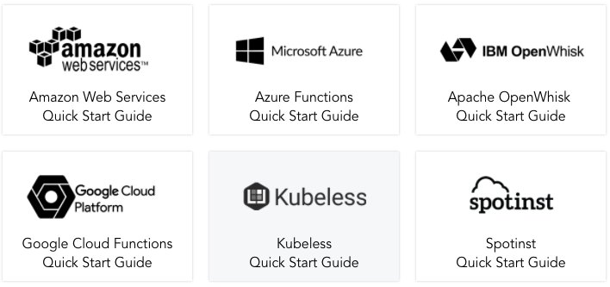
Cloud Providers

Slide 16

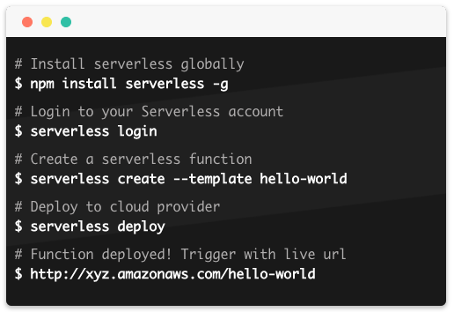

Serverless Framework
Notes:
Install the serverless framework
npm install -g serverless
The Serverless Framework is a CLI tool that allows users to build & deploy auto-scaling, pay-per-execution, event-driven functions.
Write your code, configure events to trigger your functions, then deploy & run those functions to your cloud provider via the Serverless CLI.

Slide 17
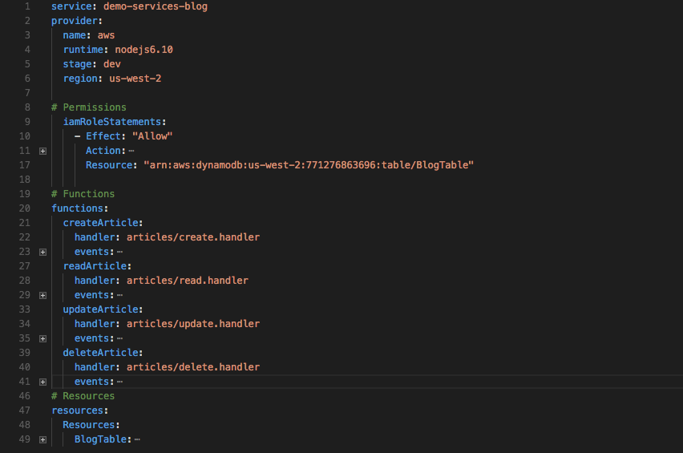

Slide 18
Reference list
Cagatay Gurturk (2017) Building Serverless Architectures
Peter Sbarski (2017) Serverless Architectures on AWS

Slide 19

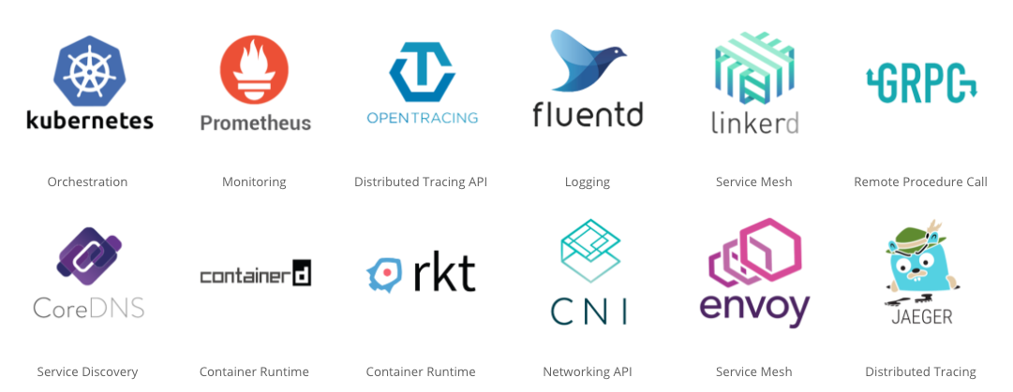

Slide 20
Demo

Slide 21
Architecture

Slide 22
npm install -g serverless
sls create -t aws-nodejs -n eva0-services-loan-app
sls deploy -f hello
sls invoke -f hello
sls invoke local -f hello
sls invoke -f evaluate -p event.json
sls invoke local -f evaluate -p event.json
npm init -y
npm install --save aws-sdk
npm install --save uuid

